Slide 1
Notes:
My name is Don Griggs. I am on the Board of KLWA and the Director of our Climate Change Observatory. I want to thank Susan Gallo and the Maine Lake Society for inviting me to speak today about a topic we are concerned about. Boat Wake impacts on lakes.
The Kezar Lake Watershed Association (KLWA) was established in July 1969, now celebrating its 50th Anniversary.
Our purpose is to preserve, protect and maintain the ecological, scenic and recreational resources of Kezar Lake and its watershed for the benefit and enjoyment of residents, summer residents, and visitors, now and in future generations.
The Kezar Lake Watershed Association is a leader in lake protection. We work with local officials to promote safety, protect water quality, and encourage responsible stewardship of the lake and its watershed. We maintain a comprehensive, scientifically-based water quality research and monitoring program. We encourage understanding of the lake and watershed resources through our annual educational meeting, public forums, workshops, and the distribution of educational publications.
The KLWA established a Climate Change Observatory (CCO) in 2013 to observe, measure, and analyze long-term climate change trends and to address their impact upon the waters, lands, and wildlife of the Kezar Lake watershed. KLWA has an extensive website, klwa.us with pages and reports on water quality, climate change, loons, lake patrol, fisheries, Lake Dwellers Handbook and other topics concerning our watershed. KLWA also has a 24x7x365 weather station and webcam with all data and images available on our website.
KLWA is 501(c)(3) non-profit organization which relies solely on contributions, membership dues and grants to fund its activities and projects.

Slide 2
Consequences of Slow Speed Power Boat Activities
A presentation to enlighten boaters on the effects of slow speed power boat wake generation and operations in shallow water
Presented by the Kezar Lake Watershed Association
May 2021
Don Griggs griggsd@aol.com
Each slide has a “Notes” page with explanatory information.
Notes:
This presentation addresses the problems generated by slow speed (6 to 12 mph) power boat activities, especially boat wakes generated in the sports of wake surfing, wake boarding and slow speed tubing.
This presentation also addresses problems associated with slow speed boating in shallow water (less than 20 feet deep).
This is an Executive Summary describing the threat associated with these activities, the causes and the recommended mitigating guidelines.
This presentation will run in an annotated version in the Power Point slideshow mode.

Slide 3
Notes:
To give you an orientation about where we are and the area of our focus, I show this map of the Kezar Lake watershed, a 56 square mile area in Western Maine, 20 miles East of Mt. Washington NH. The watershed is about 92% forested. The watershed includes the 2700 acre lake and 6 small ponds. There are 4 major streams and 4 minor streams that drain into the lake. The lake drains to the South into the Saco river.

Slide 4
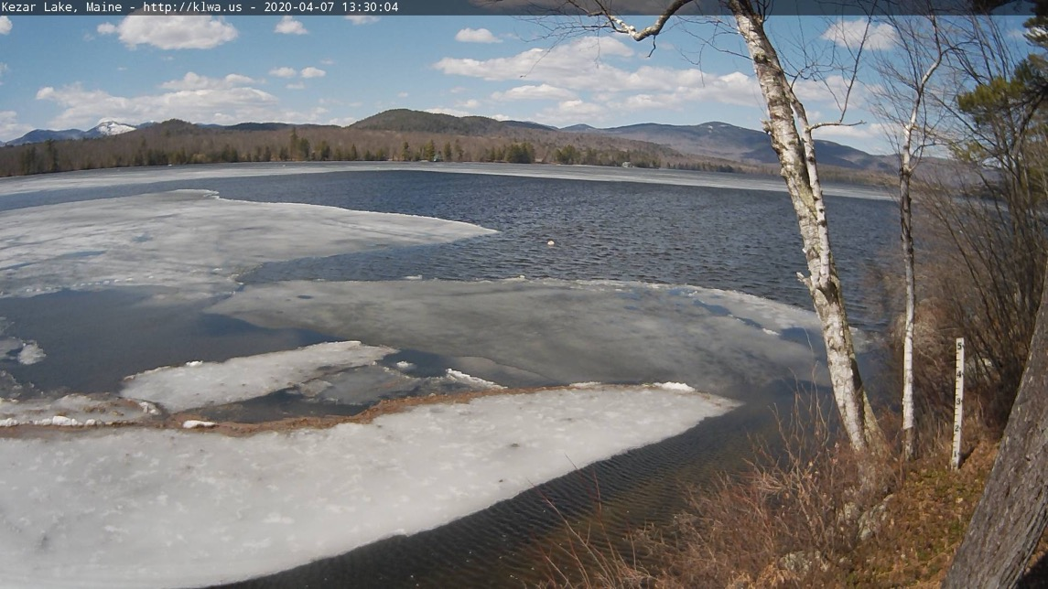
Kezar Lake - April 7, 2020 Webcam Image, klwa.us
Notes:
This Kezar Lake photo from our webcam shows a view just South of Boulder Brook looking West to Northwest. The lake is about half a mile across at this point. The snow-covered mountain in the upper left is Baldface, just inside New Hampshire.

Slide 5
The Threat to Our Lake Environment
We have become very concerned about the impact large boat wakes and slow speed boating activities are having on our lake
  Erosion of the shore line
  Safety of other boating activities – kayaks, paddle boards, canoes
  Damage to docks and moored boats
  Scouring of the lake bottom
We are contacting other lake associations to get their observations and opinions about these problems
We are seeking ways to mitigate/control inappropriate boating activities
  Establish guidelines for responsible boating
  Education
  Legislation
Notes:
As the years pass, we have seen more and larger power boats on the lake. There are also many more small water craft such as kayaks, paddleboards, small sail boats, and canoes.
However, the greatest change has been the introduction of the new water sports of wake surfing and wake boarding. These activities require very powerful boats that are designed to create large wakes, 4 feet high or more.
This is a nationally recognized problem and many lake associations and government officials are trying to deal with it. Some States have enacted regulations governing the sport of wake surfing.
KLWA is focusing on education of boaters that use our lake with guidelines for responsible boating.
KLWA is seeking ideas from other lake associations about how to best deal with these new challenges, including the possibility of legislation.

Slide 6
Slow Speed Boating – 6 to 12 mph
There are 2 aspects to slow speed power boating activities
  Wake creation
  Bottom scouring
Notes:
This presentation is divided into two sections – wake creation and bottom scouring

Slide 7
What is the Threat from Boat Wakes?
We are especially concerned about Large wakes – 3 feet or more which cause:
  Shore line erosion and degradation of water quality
  Danger to small craft on the water – kayaks, canoes, paddle boards small sail boats
    Cause upset and possible serious safety issues
    Injure boaters
    Cause damage to watercraft
  Damage to watercraft at dock or anchor
    Slamming boats into docks damaging boat and/or dock
    Break mooring lines, leading to further damage
  Upset or damage to aquatic life – especially nesting loons
  Danger to Swimmers
  Other boat operators and property owners irritation to the point of confrontation or taking counter actions
An additional threat comes from slow speed boating in shallow water
  Where propeller wash interacts with the lakebed and stirs up sediment and destroys vegetation and aquatic habitat.
Notes:
These specialty boats, called wake boats, when operating in the wake surfing mode, generating 4 foot wakes that are a serious threat to our lake: its water quality, safety of other boaters, and personal property along the shorelines.
The 200 foot “No Wake Zone” that is a Maine law is seriously inadequate to protect the shorelines from erosion and damage from 4 foot wakes if they are generated just outside of the 200 foot zone.
Another threat is from slow speed boating in shallow water where the propeller wash interacts with the lake bed and stirs up sediment and destroys vegetation and aquatic habitat.

Slide 8
Types of Boats Making Wakes
Boats on our lake with virtually no wake – wind and /or muscle powered
  Sail boats
  Canoes, kayaks, rowboats, paddleboards
Boats with little to moderate wakes – wakes 4 to 12 inches
  Low power boats – less than 10HP
  Personal Watercraft
Boats with “medium” wakes – wakes 1 to 2 feet
  General runabout boats, ski boats, pontoon boats
Boats with very large wakes – wakes 2 to 4 feet
  Wake Boats in wake surfing or wake boarding mode
  General runabout boats operating at about 6 – 12 mph
  Very large boats - > 24 feet long
All boat wakes vary significantly depending on boat speed as I will show
Boat design and loading also influence how much wake is created
Notes:
This slide shows the amount of wake associated with different types of boats.

Slide 9
Boat Activities That Cause Wakes
Boat Activity with “medium” wakes
  General touring of the lake – speed 15 – 35 mph; wakes 1 to 2 feet
  Water skiing – speed 25– 35 mph; wakes - 0.5 to 1 feet
  Tubing – high speed 15 – 20 mph; wakes – 1 to 2 feet
  Fishing – high speed bass boats 20 – 60 mph; wakes 0.4 to 1 foot
Boat Activity with very large wakes
  Tubing – slow speed 5 – 12 mph; wakes – 1 to 3 feet
  Wake boarding – speed 15 – 25 mph; wakes 2 to 3 feet
  Wake surfing – speed 8 – 12 mph; wakes 3 to 4 feet +
  Large boats general use – speed 5 to 25 mph; wakes 1 to 3 feet
Notes:
This chart shows the different amount of wake associated with different boating activities.

Slide 10
The Nature of Boat Wakes
Wakes are formed by 2 actions of a boat
  Displacement wakes – boats “plowing” the water with the bow
  Planning wakes – Transverse waves from the stern and propellers
For Classical Wakes, Once formed –
  Wakes decay as the distance from the “sail line” as d^{- 0.33}
  Wakes decrease by half for every 8 fold increase in distance from the sail line
Notes:
Boat wakes are formed by 2 actions of the boat:
- Primarily, a displacement wake is formed by the boat “plowing the water”, and
- Planning wakes formed by the stern and propellers
Classically, Boats wakes decay according to a mathematical formula such that the wave height reduces by half for every 8 fold increase in distance from the sail line (the path of the boat). This chart shows that a 4 foot wake decays to 2 feet at 160 feet from the sail line and down to 1 foot at 1280 feet from the sail line.
Reference: Greg Cox, "On Wave Decay," May 2002, Australian Naval Architect 6(2):30-32 as presented in BoatWakes.org; ESTIMATED DISTANCES THAT WAKES TRAVEL; Click for research on wave decay; Wave Decay

Slide 11
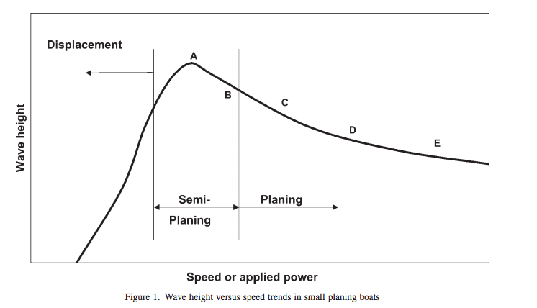
Boat Speed vs Wave Height
This chart shows the wake height versus boat speed
Note that the maximum wake generation occurs at a relatively slow speed—6 to 12 mph
6
12
Notes:
Wake height generation is at its peak at relatively slow speed, that is before a boat reaches planning speed. Wake boats operate at about 10 mph for wake surfing with full ballast weight so the boat is pushing the greatest amount of water, creating the largest possible wake. These boats also use “wake plates” to shape the wake to the port side or starboard side of the boats as desired.
This chart shows the general nature of the relationship of wake height vs boat speed.
Wave height is on the vertical axis and boat speed is on the horizontal axis.
Chart reference: Stephen T. Maynord; 2004; Wave Height from Planing and Sem-Planing Small Boats; US Army Corps of Engineers. Engineering Research and Development Center, Costal and Hydraulics Laboratory, Vicksburg MS 39180. 6 and 12 mph reference points added.

Slide 12
How Much Wake do we Get?
Initial Wave Height Ft. | Height at 200 ft. | Height at 300 ft. | Height at 400 ft. | Height at 500 ft. | Distance to 1 Foot Height
5 | 2.32 ft. | 2.03 ft. | 1.84 ft. | 1.7 ft. | 2,500 ft.
4 | 1.86 ft. | 1.62 ft. | 1.48 ft. | 1.37 ft. | 1,280 ft.
3 | 1.39 ft. | 1.22 ft. | 1.11 ft. | 1.03 ft. | 540 ft.
2 | 0.93 ft. | 0.81 ft. | 0.74 ft. | 0.68 ft. | 160 ft.
1 |  |  |  |  | 20 ft.
So How about Selecting 500 feet as the stand off distance for very large wake activities?
The Current Maine law of 200 feet for wakes starting at 2+ feet is reasonable.
Notes:
This chart shows the wake height at various distances from the sail line.
A 4 foot wake does not get down to 1 foot height until 1,280 feet.
While a 1,000 foot standoff distance would be preferable, we have selected 500 feet as a compromise that would be more acceptable on a lake as small as Kezar. We feel that it is better to have a guideline that people are more likely to follow rather than one that is so onerous that they will just ignore it.
A 3 foot wake just about gets to 1 foot height at 500 feet.
Wakes of about 2 feet or less are OK considering the Maine 200 foot no-wake law.
There is a Canadian study that did extensive testing of wake boat wakes and recommended that wake surfing activities be conducted at least 1,000 feet from shorelines to avoid erosion.
Reference: Sara Mercier-Blais and Yves Prairie; June 2014; Project Evaluation of the Impact of Waves Created by Wake Boats on the Shores of the Lakes Memphremagog and Lovering; University of Quebec at Montreal, Case postale 8888, Succ., Centre-Ville, Montréal (Qc) H3C 3P8

Slide 13
We are Especially Concerned About Wake Boats
These boats are designed to make very large wakes – 4 feet or more
They are used to support the relatively new sport of “Wake Surfing”
Although they are very expensive, they are proliferating in our area.
We have had many complains about the large wakes these boats create. Even greater impact occurs when 3 to 5 of these boats are operating in the same area at the same time.
We are not as concerned about the wake boats per se but how and where they are used.
These boats have the capability to be operated in ways and locations that can cause damage, injury and erosion
Notes:
This slide introduces wake boats and their use to create large wakes.
Note that it is not the wake boat per se that is the problem but how and where they are used.

Slide 14
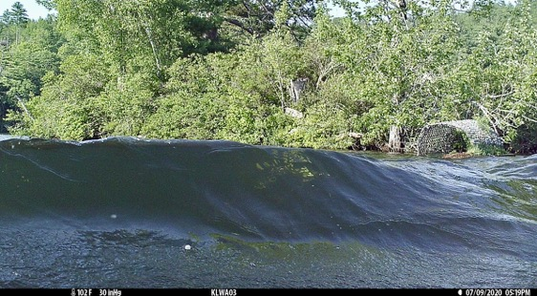
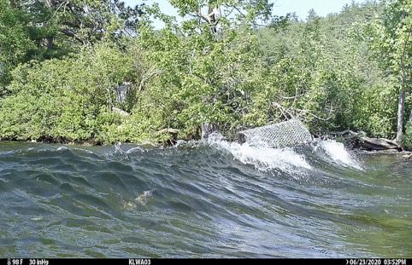
Wake Boat Wake Disturbing Loon Nest Platform
Wake boat path 250 feet to left. Wake propagating to right.
Loon nest platform tipping to the point where an egg
could roll into the water. Wake could also wash through
the nest, cracking an egg or flushing it out of the nest.
Notes:
These images were taken by a trail camera setup to view loons on the nest in one of our floating loon nest platforms. The images show a large wake created by a wake boat about 250 feet to the left propagating towards the shoreline to the right. The platform was anchored on a small island in front of the camera. The wakes appear to be about 2 feet high. The consequence of the loon platform tilting as you see, could be that an egg may roll out of the nest into the water. Another possibility is that a wake could wash right through the nest and crack an egg or flush it out of the nest into the water. While our loon nesting platforms are designed to absorb natural wave action, no raft can overcome the rocking motion caused by a close encounter with a wake boat wake.

Slide 15
About Wake Boats – Typical Specifications
Length – 22 - 26 feet
Width – 8.5 feet
Weight – up to 9,800 lbs.
Passenger Capacity – 17
Ballast – 2,000 – 5,000 lbs. in addition to weight of boat above
Engine – 400 to 575 HP
Cost – $90,000 to $250,000
Notes:
This slide shows the basic specifications of a typical wake boat.

Slide 16
What should we do about addressing large wakes?
Create boating Guidelines concerning large wakes on Kezar Lake
Educate boaters
  Signs at public launch sites
  Instructions by Marina staff
  Use the Lake Patrol to encourage wake surfer and wake board boaters and anyone creating large wakes to abide by our (KLWA) Guidelines
  Publish Newsletter articles
Seek the support of LEA, MLS and LSM (VLMP) and other lake associations to petition Maine legislatures to establish wake surfing regulations
Notes:
This page shows what we have done and are are doing to address the large wake problem.
We have created reasonable guidelines that we encourage boaters to follow as to where in the lake wake surfing and other large wake activities should occur.
We believe that education of boaters is the most effective way to try to influence the behavior to boaters wanting to do wake surfing and wake boarding.
We are also seeking support from other lake associations to get ideas on how to deal with this problem and to find a way to get the Maine legislature to take action regarding wake surfing regulations.
LEA = Lakes Environmental Association
MLS = Maine Lakes Society
LSM = Lake Stewards of Maine

Slide 17
KLWA Guidelines for Boating Activities Causing Large Wakes in Kezar Lake
Wake surfing activities should be operated at least 500 feet from shorelines, boats that are underway, anchored or moored and persons in the water.
Other boating activities that create large wakes (2-3 feet), especially wake boarding, slow speed tubing and touring (boats “plowing the water” at slow speed of 6 to 12 mph), should be operated at least 300 feet from shorelines, docks and anchored swimming floats, navigation buoys, boats that are underway, anchored or moored and persons in the water.
Notes:
KLWA requests that all boaters observe these guideline out of respect for other boaters, lakeshore property owners and the quality of water in Kezar lake.
These guidelines are of a voluntary compliance nature as they do not have the force of law.

Slide 18
Now Consider the Related Threat - Propeller Wash Impact on Lake Bottom
Propeller wash (or water jet wash) in shallow water can have a devastating effect on the lake bottom
  Scouring of the bottom
  Resuspending sediment – especially phosphorus
  Destruction of aquatic vegetation and water critters and their habitats
Wake Boats have a 20⁰ angle on the propeller shaft and another 10 - 15⁰ in a bow up posture so thrust of propeller wash is about 30⁰ down.
The velocity of the jet wash is proportional to the propeller pitch and propeller rpms and the jet wash speed decays linearly with distance.
Notes:
We call this threat "related" because it happens at the same boat speeds that generate the maximum wakes e.g. 8 to 10 mph as we shall see.
This bottom scouring is a major threat to the water quality and can be devastating to marine life.
This can be a problem for most all power boats but especially for wake boats operating in the wake surfing mode.
Outboard and I/O motors have their jet wash almost directly back except when accelerating at startup.
Inboard motors have a propeller pointed down at rest and even more down pointing at startup or when in the wake surfing mode or other slow speed (6 – 12mph) activities such as slow speed tubing or just touring.

Slide 19
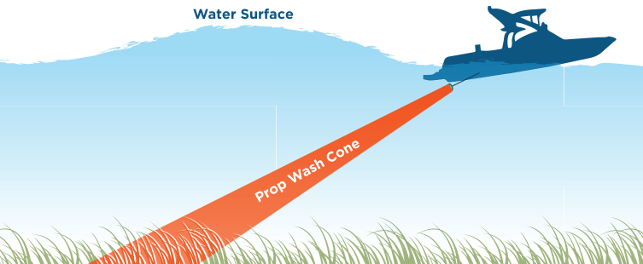
Propeller Wash Impact on Lake Bottom
Notes:
This diagram depicts the prop wash cone pointing towards the bottom when in a start up or wake surfing mode.

Slide 20
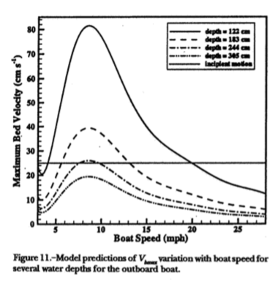
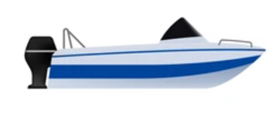

Water Jet Velocity vs Boat Speed
Max prop jet speed is at about 9mph
At very slow speed and high speed the jet speed is much less and not so much of a problem
So, we focus on boating activities in shallow water where boat speed is 6-12 mph
Depth = 4’
6’
Jet Velocity from an outboard boat that will disturb 0.33mm sand on the bottom
11’
12.5’
Notes:
This graph shows propeller jet speed on the vertical axis and boat speed on the horizontal axis. The curves shows water jet speed on the lake bottom for a16 foot, 150hp outboard motorboat moving at various speeds for various depths of water. The horizontal line shows the water jet speed that will disturb 0.33mm sand on the bottom, a standard used by the study group that did this analysis. Finer grained sand will be disturbed and much lower velocities. Note that the thrust of the outboard motor is straight back as opposed to an inboard motor that has its propeller shaft angled down at about 15-20 degrees. Reference: M. M. Beachler & D. F. Hill (2003) Stirring up Trouble? Resuspension of Bottom Sediments by Recreational Watercraft, Lake and Reservoir Management, 19:1, 15-25, DOI: 10.1080/07438140309353985; https://doi.org/10.1080/07438140309353985
So, a major observation here is that we see that the maximum propeller jet speed reaching the bottom occurs at about 9mph. Faster or slower and the velocity of the propeller jet speed reaching the bottom is much less.
So we have the worst condition from both wake generation and bottom scouring occurring at the same speed of about 9 mph.
We have calculated that a wake boat operating in the wake surfing mode with its water jet pointing down at about 30 degrees, needs to be in at least 20 feet of water to avoid scouring the bottom.

Slide 21
Slow Speed Boating Gives Max Impact to Wake Generation and Bottom Disturbance
Note that the max wake generation speed and max bottom scouring both occur at a speed of about 9 mph.
The boating activities that are associated with these speeds are wake surfing and slow speed tubing.
Wake surfing can have the greatest adverse impact on the shorelines, docks and other boaters as well as on the bottom if in shallow water.
6
12
Max Wave Impact at 9 mph
Max Bottom Impact at 9 mph
Notes:
This slide first shows the max bottom scouring graph we just saw and then the max wake creation graph and then overlays these 2 graphs to show that the worst condition for both wake generation and bottom scouring occur at the same speed of about 9mph, plus of minus 3 mph depending on individual boat types.

Slide 22
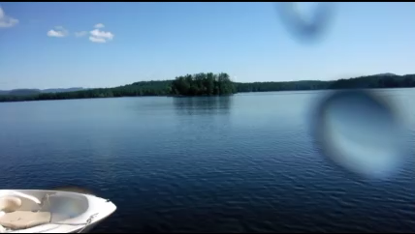
Propeller Wash Impact in Lower Bay
Test date 8.8.16
Lower Bay Kezar Lake
9 feet of water
Test boat – 18’ Sea Ray
130 HP stern drive
1 person in boat
Nikon underwater camera
On pole, 4’ off bottom
Turbidity meter showed
10x increase
Notes:
This video shows the bottom scouring from an 18’ Sea Ray boat with a 130hp stern drive (i/0) starting up in 9 feet of water. There is an underwater video camera that captures the impact on the bottom from this startup action. Note the sediment cloud that is stirred up first followed by all sorts of vegetation stirred up by the boat propeller wash.

Slide 23
Lake Bed Sediment Disturbance from Wake Surfing
Notes:
This diagram depicts the propeller wash cone pointing towards the bottom when in a start up or wake surfing mode.

Slide 24
KLWA Guidelines for Boating Activities Causing Large Wakes and Bottom Scouring in Kezar Lake
Wake surfing activities should be operated at least 500 feet from shorelines.
Other boating activities that create large wakes (2-3 feet), especially wake boarding, slow speed tubing and touring (boats “plowing the water” at slow speed of 6 to 12 mph), should be operated at least 300 feet from shorelines, docks and anchored swimming floats, navigation buoys, vessels that are underway, anchored or moored and persons in the water.
Further, no such slow speed (6 -12mph) activities should occur in water less that 20 feet deep due to propeller wash scouring of the lake bottom.
Notes:
Again, KLWA requests that all boaters observe these guideline out of respect for other boaters, lakeshore property owners and the quality of water in Kezar lake.
These guidelines are of a voluntary compliance nature as they do not have the force of law.
Our premise is that reasonable people will follow reasonable guidelines once they know the consequences of the adverse effects of large wakes and the potential for bottom scouring.

Slide 25
KLWA Flyer for Boating Activities
Notes:
This is the KLWA Flyer that we have made and distributed to as many boaters as possible. This is a two-sided 8.5 x 11 flyer printed on durable paper stock.
The map shows those areas of the lake that are 500 feet from shorelines and over 20 feet deep. Note that since the lower bay averages about 10 feet deep, there are no acceptable areas for these large wake producing activities.
We also have a poster version to use at meetings and events.

Slide 26
Notes:
This presentation has been protected as a “read only” document to prevent inadvertent modification. Contact is Don Griggs, griggsd@aol.com.

